Slide 1
TEMPLATES & EXCEPTIONS
NILANJANA G. BASU
HITK

Slide 2
THE PROBLEMS AS LISTED…
Suppose you want to write a function that returns the absolute value of two numbers.
Normally it would look like this:
int abs(int n) //absolute value of ints
{
return (n<0) ? -n : n; //if n is negative, return -n
}
But now if you want to write the same for float or long you have to write the same
function for that data type.
long abs(long n) //absolute value of longs
{
return (n<0) ? -n : n;
}
float abs(float n) //absolute value of floats
{
return (n<0) ? -n : n;
}

Slide 3
…THE PROBLEMS AS LISTED
Obviously function overloading in C++ will help you with this
but nevertheless you have to write the same body over and
over again which is quite tedious.
Also, if you find you’ve made an error in one such function,
you’ll have to remember to correct it in each function body.

Slide 4
THE SOLUTION…
It would be nice if there were a way to write such a function just once,
and have it work for many different data types.
YAYY! We have TEMPLATES.
template <class Type> //a class template
class Stack
{
private:
Type st[MAX]; //stack: array of any type
int top; //number of top of stack
public:
Stack() //constructor
{ top = -1; }
void push(Type var) //put number on stack
{ st[++top] = var; }
Type pop() //take number off stack
{ return st[top--]; }
};
template <class T> //a function template
T abs(T n)
{
return (n < 0) ? -n : n;
}

Slide 5
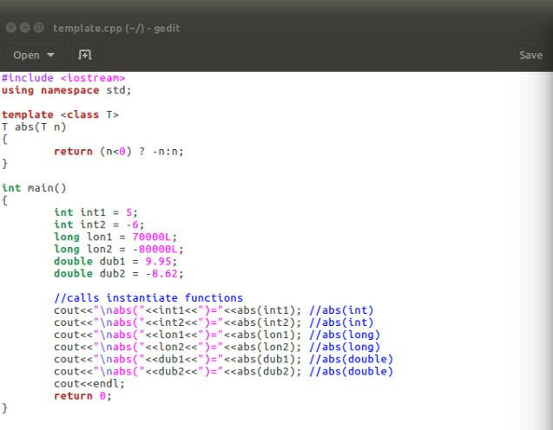
…THE SOLUTION…
Consider the following program showing the implementation of a simple function template:

Slide 6
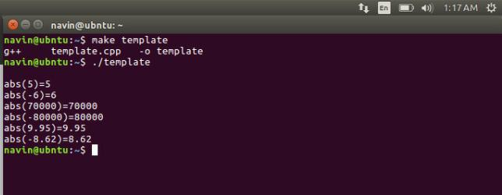
…THE SOLUTION…
As we can see, the abs() function now works with all three of the data types (int, long, and
double) that we use as arguments.
It will work with other user-defined data types as well provided the less-than operator(<)
and minus operator(-) are overloaded appropriately.

Slide 7
…THE SOLUTION…
One function template in
listing (source file)
Template <class T>
T func(T arg)
{
. . .
}
Argument type determines
function instantiation
Int func(int arg)
{
. . .
}
float func(float arg)
{
. . .
}
char func(char arg)
{
. . .
}
Many template functions in memory

Slide 8
…THE SOLUTION
THE FUNCTION TEMPLATE SYNTAX
Called the template argument,
throughout the definition of the
template, whenever a specific
data type such as int would
ordinarily be written, we
substitute the template
argument, T.
The keyword class, within
the angled brackets, might
just as well be called type.
The template keyword signals the compiler that
we’re about to define a function template.
template <class T>
T abs(T n)
{
return (n<0) ? -n : n;
}
The function template itself doesn’t cause the compiler to generate any code.
Code generation doesn’t take place until the function is actually called (invoked) by
a statement within the program.

Slide 9
INSTANTIATION…
Guess, what does the compiler do when it sees the template keyword and the
function definition that follows it?

Slide 10
…INSTANTIATION…
Basically, NOTHING right away!

Slide 11
…INSTANTIATION…
What does the compiler do when it sees the template keyword and the
function definition that follows it?
Basically, NOTHING right away!
The function template itself doesn’t cause the compiler to generate any code.
Code generation doesn’t take place until the function is actually called (invoked) by
a statement within the program.

Slide 12
…INSTANTIATION…
Taking from the example:
abs(int1); //abs(int)
When the compiler sees such a function call,
it knows that the type to use is int, because that’s
the type of the argument int1.

Slide 13
…INSTANTIATION…
Taking from the example:
abs(int1); //abs(int)
When the compiler sees such a function call,
it knows that the type to use is int, because that’s
the type of the argument int1.
It generates a specific version of the abs() function for type
int, substituting int wherever it sees the name T in the function template.

Slide 14
…INSTANTIATION…
Taking from the example:
abs(int1); //abs(int)
When the compiler sees such a function call,
it knows that the type to use is int, because that’s
the type of the argument int1.
It generates a specific version of the abs() function for type
int, substituting int wherever it sees the name T in the function template.
This is called instantiating the function template.

Slide 15
…INSTANTIATION…
Taking from the example:
abs(int1); //abs(int)
When the compiler sees such a function call,
it knows that the type to use is int, because that’s
the type of the argument int1.
It generates a specific version of the abs() function for type
int, substituting int wherever it sees the name T in the function template.
This is called instantiating the function template.
The compiler decides how to compile the function based entirely on the data type used in
the function call’s argument (or arguments).

Slide 16
…INSTANTIATION…
Taking from the example:
abs(int1); //abs(int)
When the compiler sees such a function call,
it knows that the type to use is int, because that’s
the type of the argument int1.
It generates a specific version of the abs() function for type
int, substituting int wherever it sees the name T in the function template.
This is called instantiating the function template.
The compiler decides how to compile the function based entirely on the data type used in
the function call’s argument (or arguments).
The compiler also generates a call to the newly instantiated function, and inserts it into the
code where abs(int1) is.

Slide 17
…INSTANTIATION
Taking from the example:
abs(int1); //abs(int)
When the compiler sees such a function call,
it knows that the type to use is int, because that’s
the type of the argument int1.
It generates a specific version of the abs() function for type
int, substituting int wherever it sees the name T in the function template.
This is called instantiating the function template.
The compiler decides how to compile the function based entirely on the data type used in
the function call’s argument (or arguments).
The compiler also generates a call to the newly instantiated function, and inserts it into the
code where abs(int1) is.
A NEW EXAMPLE COMING UP AHEAD.

Slide 18
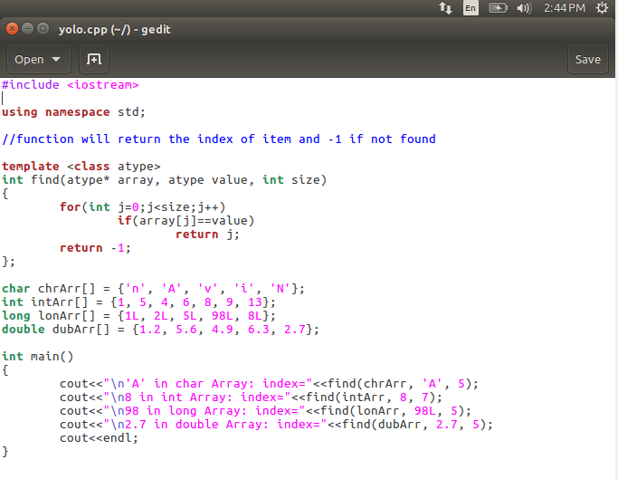
ANOTHER EXAMPLE…
The compiler generates four different
versions of the function, one for each
type used to call it.
It finds a ‘A’ at index 1
in the character array, 8 in the integer
array, and so on.
The program

Slide 19
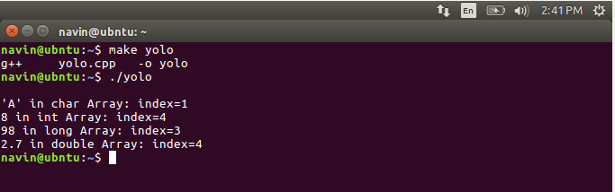
…ANOTHER EXAMPLE...
The compiler generates four different
versions of the function, one for each
type used to call it.
It finds a ‘A’ at index 1
in the character array, 8 in the integer
array, and so on.
The program
The output

Slide 20
…ANOTHER EXAMPLE...
When a template function is invoked, all instances of the same template argument must be of
the same type.

Slide 21
…ANOTHER EXAMPLE...
When a template function is invoked, all instances of the same template argument must be of
the same type.
For instance the following will generate a compiler error as shown below:
int intArr[] = {1, 3, 5, 7}; //int array
float f1 = 5.0; //float value
int value = find(intArr, f1, 4); //uh, oh

Slide 22
…ANOTHER EXAMPLE...
When a template function is invoked, all instances of the same template argument must be of
the same type.
For instance the following will generate a compiler error as shown below:
int intArr[] = {1, 3, 5, 7}; //int array
float f1 = 5.0; //float value
int value = find(intArr, f1, 4); //uh, oh
yolo.cpp: In function ‘int main()’:
yolo.cpp:22:55: error: no matching function for call to ‘find(int [7], float&, int)’
cout<<"\nf1 in int Array: index="<<find(intArr, f1, 7);
^
yolo.cpp:8:5: note: candidate: template<class atype> int find(atype*, atype, int)
int find(atype* array, atype value, int size)
^
yolo.cpp:8:5: note: template argument deduction/substitution failed:
yolo.cpp:22:55: note: deduced conflicting types for parameter ‘atype’ (‘int’ and ‘float’)
cout<<"\nf1 in int Array: index="<<find(intArr, f1, 7);

Slide 23
…ANOTHER EXAMPLE...
Because the compiler expects all instances of atype to be the same type. It can generate a
function:
find(int*, int, int);
but it cannot generate the function:
find(int*, float, int);
SYNTAX VARIATION
template<class atype> int find(atype* array, atype value, int size)
{
//function body
}

Slide 24
…A BIT MORE
You can use more than one template argument in a function template.
Suppose you want to use the find function. If the array is too large then type long would
be necessary for the array size, instead of type int. Then this might help:
template <class atype, class btype>
btype find(atype* array, atype value, btype size)
{
for(btype j = 0; j<size; j++) //note use of btype
if(array[j]==value)
return j;
return static_cast<btype>(-1);
}
Now you can use either type int or type long (or even a user-defined type) for the size,
whichever is appropriate. The compiler will generate different functions based not only on the
type of the array and the value to be searched for, but also on the type of the array size.

Slide 25
A BIT MORE…
You can use more than one template argument in a function template.

Slide 26
…A BIT MORE…
You can use more than one template argument in a function template.
Suppose you want to use the find function. If the array is too large then type long would
be necessary for the array size, instead of type int.

Slide 27
…A BIT MORE…
You can use more than one template argument in a function template.
Suppose you want to use the find function. If the array is too large then type long would
be necessary for the array size, instead of type int. Then this might help:
template <class atype, class btype>
btype find(atype* array, atype value, btype size)
{
for(btype j = 0; j<size; j++) //note use of btype
if(array[j]==value)
return j;
return static_cast<btype>(-1);
}

Slide 28
WHY NOT MACROS?...
AN OBVIOUS DOUBT
IF
YOU ARE FOLLOWING!

Slide 29
…WHY NOT MACROS?...
For example, the abs() function could be defined as:
#define abs(n) ( (n<0) ? (-n) : (n) )

Slide 30
…WHY NOT MACROS?...
For example, the abs() function could be defined as:
#define abs(n) ( (n<0) ? (-n) : (n) )
Turns out that there are several problems with them.

Slide 31
…WHY NOT MACROS?...
For example, the abs() function could be defined as:
#define abs(n) ( (n<0) ? (-n) : (n) )
Turns out that there are several problems with them.
One is that macros don’t perform any type checking.

Slide 32
…WHY NOT MACROS?...
For example, the abs() function could be defined as:
#define abs(n) ( (n<0) ? (-n) : (n) )
Turns out that there are several problems with them.
One is that macros don’t perform any type checking.
Also, the type of the value returned isn’t specified, so the compiler can’t tell
if you’re assigning it to an incompatible variable.

Slide 33
…WHY NOT MACROS?
For example, the abs() function could be defined as:
#define abs(n) ( (n<0) ? (-n) : (n) )
Turns out that there are several problems with them.
One is that macros don’t perform any type checking.
Also, the type of the value returned isn’t specified, so the compiler can’t tell
if you’re assigning it to an incompatible variable.
In any case, macros are confined to functions that can be expressed in a single statement.
On the whole it’s best to avoid them.

Slide 34
ANOTHER PROBLEM!...
Consider the STACK class:
class Stack
{
private:
int st[MAX]; //array of ints
int top; //index number of top of stack
public:
Stack(); //constructor
void push(int var); //takes int as argument
int pop(); //returns int value
};

Slide 35
…ANOTHER PROBLEM!...
If we wanted to store data of type long in a stack, we would need to define a completely new
class as such:
class LongStack
{
private:
long st[MAX]; //array of longs
int top; //index number of top of stack
public:
LongStack(); //constructor
void push(long var); //takes long as argument
long pop(); //returns long value
};

Slide 36
…ANOTHER PROBLEM!...
If we wanted to store data of type long in a stack, we would need to define a completely new
class as such:
class LongStack
{
private:
long st[MAX]; //array of longs
int top; //index number of top of stack
public:
LongStack(); //constructor
void push(long var); //takes long as argument
long pop(); //returns long value
};
Similarly, we would need to create a new stack class for every data type we wanted to store
but we have other important things to do than worrying about the same concept again and
yet again!

Slide 37
THE SOLUTION…
Yayy?
The template concept can be extended to classes too. As such:
template <class Type>
class Stack
{
private:
Type st[MAX]; //stack: array of any type
int top; //number of top of stack
public:
Stack() //constructor
{ top = -1; }
void push(Type var) //put number on stack
{ st[++top] = var; }
Type pop() //take number off stack
{ return st[top--]; }
};

Slide 38
…THE SOLUTION…
Yayy?
The template concept can be extended to classes too. As such:
template <class Type>
class Stack
{
private:
Type st[MAX]; //stack: array of any type
int top; //number of top of stack
public:
Stack() //constructor
{ top = -1; }
void push(Type var) //put number on stack
{ st[++top] = var; }
Type pop() //take number off stack
{ return st[top--]; }
};
Here the class Stack is presented as a template class.

Slide 39
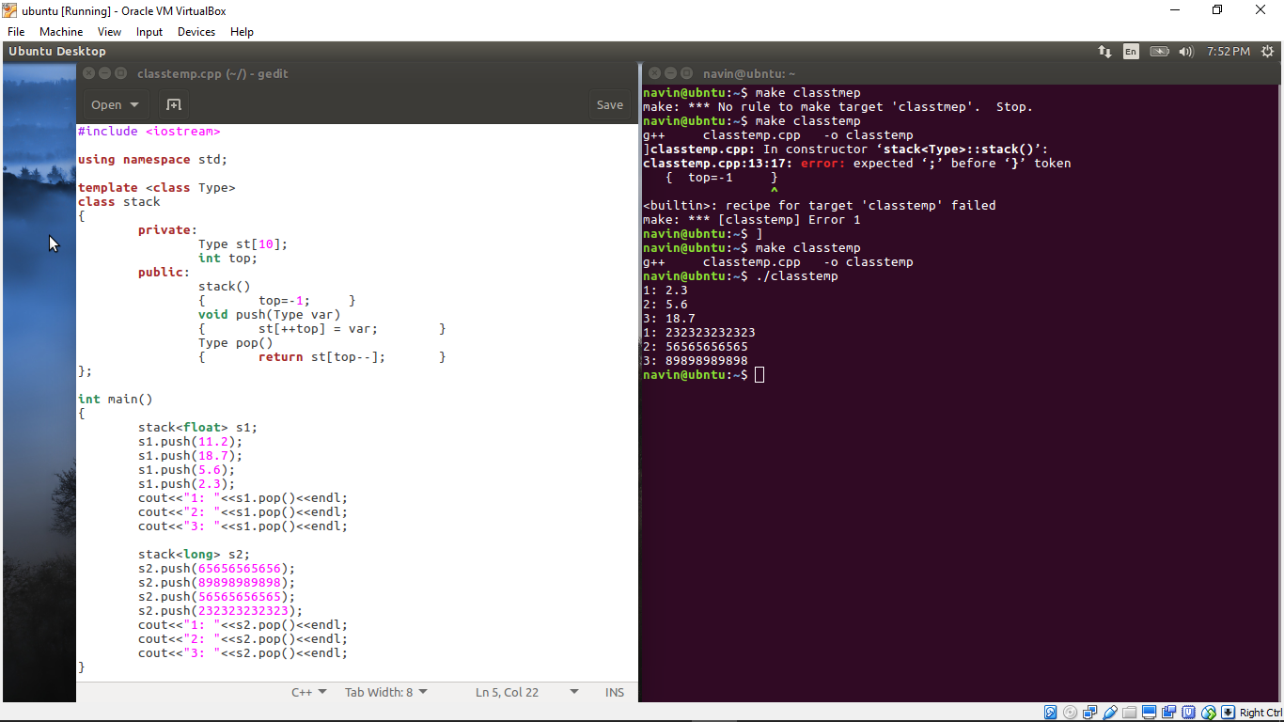
…THE SOLUTION…
The program

Slide 40
…THE SOLUTION…
The output.

Slide 41
…THE SOLUTION…
template <class T>
class Aclass
{
// statements
// use T
// in place of
// a type
}
Aclass<float> obj1;
Aclass<char> obj4;
obj 1
obj 2
obj 4
stores float
Aclass<int> obj2;
stores ints
stores chars
obj3
obj5
Aclass<int> obj3;
stores ints
stores chars
Multiple objects of different classes in memory

Slide 42
…THE SOLUTION…
THE CLASS TEMPLATE SYNTAX
A template argument, named Type in this example, is then used, instead of a fixed data type
such as int, everyplace in the class specification where there is a reference to the type of the
array st.
template <class Type>
class Stack
{
//data and member functions using template argument Type
};

Slide 43
INSTANTIATION…
Classes, however, are instantiated by defining an object using the template argument.

Slide 44
INSTANTIATION…
Classes, however, are instantiated by defining an object using the template argument.
Stack<float> s1;
This creates an object, s1, a stack that stores numbers of type float.

Slide 45
INSTANTIATION…
Classes, however, are instantiated by defining an object using the template argument.
Stack<float> s1;
This creates an object, s1, a stack that stores numbers of type float.
The compiler provides space in memory for this object’s data, using type float wherever
the template argument Type appears in the class specification.

Slide 46
INSTANTIATION…
Classes, however, are instantiated by defining an object using the template argument.
Stack<float> s1;
This creates an object, s1, a stack that stores numbers of type float.
The compiler provides space in memory for this object’s data, using type float wherever
the template argument Type appears in the class specification.
Creating a Stack object that stores objects of a different type, as in
Stack<long> s2;
creates not only a different space for data, but also a new set of member functions that operate
on type long.

Slide 47
ANOTHER WAY…
If the member functions are defined externally (outside of the class specification), we
need a new syntax.
template <class Type>
class Stack
{
private:
Type st[MAX]; //stack: array of any type
int top; //number of top of stack
public:
Stack(); //constructor
void push(Type var); //put number
Type pop(); //take number off stack
};
template<class Type>
Stack<Type>::Stack() //constructor
{
top = -1;
}
template<class Type>
void Stack<Type>::push(Type var)//put number
{
st[++top] = var;
}
template<class Type>
Type Stack<Type>::pop() //take number off
{
return st[top--];
}

Slide 48
…ANOTHER WAY…
The expression template<class Type> must precede not only the class definition, but each
externally defined member function as well as such:
template<class Type>
void Stack<Type>::push(Type var)
{
st[++top] = var;
}

Slide 49
…ANOTHER WAY…
The expression template<class Type> must precede not only the class definition, but each
externally defined member function as well as such:
template<class Type>
void Stack<Type>::push(Type var)
{
st[++top] = var;
}
The name Stack<Type> is used to identify the class of which push() is a member.

Slide 50
…ANOTHER WAY…
You must also be careful of the syntax when a member function returns a value of its
own class.

Slide 51
…ANOTHER WAY…
You must also be careful of the syntax when a member function returns a value of its
own class.
Suppose a class named Int is defined. If you used an external definition for a member function
xfunc() of any class that returned type Int, you would need to use Int<Type> for the return type
as well as preceding the scope resolution operator:
Int<Type> Int<Type>:: xfunc(Int arg)
{ }

Slide 52
EXCEPTIONS…
STATING THE OBVIOUS (JUST FOR THE RECORD):
Exceptions are errors that occur at runtime.
They are caused by a wide variety of exceptional circumstance, such as :
Running out of memory
Not being able to open a file
Trying to initialize an object to an impossible value
Using an out-of-bounds index to a vector.

Slide 53
…EXCEPTIONS…
STATING THE OBVIOUS (JUST FOR THE RECORD):
Exceptions are errors that occur at runtime.
They are caused by a wide variety of exceptional circumstance, such as :
Running out of memory
Not being able to open a file
Trying to initialize an object to an impossible value
Using an out-of-bounds index to a vector.
Without exceptions error handling becomes quite tedious as it requires a lot of code and
makes the listing convoluted and hard to read.

Slide 54
…EXCEPTIONS…
STATING THE OBVIOUS (JUST FOR THE RECORD):
Exceptions are errors that occur at runtime.
They are caused by a wide variety of exceptional circumstance, such as :
Running out of memory
Not being able to open a file
Trying to initialize an object to an impossible value
Using an out-of-bounds index to a vector.
Without exceptions error handling becomes quite tedious as it requires a lot of code and
makes the listing convoluted and hard to read.
The problem becomes more complex when classes are used, since errors may take place
without a function being explicitly called.

Slide 55
…EXCEPTIONS…
APPLICATION
CLASS
Normal code
Data
Does not interact
with class.
Member functions
Try block
Good call
Normal return
Code that interacts
with class
Good call
Normal return
ERROR
Bad call
Exception
Exception handler
(Catch block)
Displays error
message, etc.
The exception mechanism

Slide 56
…EXCEPTIONS…
The exception mechanism uses three new C++ keywords: throw, catch, and try.
class Stack
{
private:
int st[3]; //array of integers
int top; //index of top of stack
public:
class Range //exception class for Stack
{ //note: empty class body
};
Stack() //constructor
{ top = -1; }
void push(int var)
{
if(top >= MAX-1) //if stack full,
throw Range(); //throw exception
st[++top] = var; //put number on stack
}
int pop()
{
if(top < 0) //if stack empty,
throw Range(); //throw exception
return st[top--]; //take number off stack
}
};

Slide 57
…EXCEPTIONS…
int main()
{
Stack s1;
try
{
s1.push(11);
s1.push(22);
s1.push(33);
// s1.push(44); //oops: stack full
cout << “1: “ << s1.pop() << endl;
cout << “2: “ << s1.pop() << endl;
cout << “3: “ << s1.pop() << endl;
cout << “4: “ << s1.pop() << endl; //oops: stack empty
}
catch(Stack::Range) //exception handler
{
cout << “Exception: Stack Full or Empty” << endl;
}
cout << “Arrive here after catch (or normal exit)” << endl;
return 0;
}

Slide 58
…EXCEPTIONS…
There are four features of the program that deal with the exceptions.

Slide 59
…EXCEPTIONS…
There are four features of the program that deal with the exceptions.
In the class specification there is an exception class.

Slide 60
…EXCEPTIONS…
There are four features of the program that deal with the exceptions.
In the class specification there is an exception class.
There are also statements that throw exceptions.

Slide 61
…EXCEPTIONS…
There are four features of the program that deal with the exceptions.
In the class specification there is an exception class.
There are also statements that throw exceptions.
In the main() part of the program there is a block of code that may cause exceptions (the
try block)

Slide 62
…EXCEPTIONS…
There are four features of the program that deal with the exceptions.
In the class specification there is an exception class.
There are also statements that throw exceptions.
In the main() part of the program there is a block of code that may cause exceptions (the
try block)
And a block of code that handles the exception (the catch block).

Slide 63
…EXCEPTIONS…
THROWING AN EXCEPTION
In the Stack class an exception occurs if the application tries to pop a value when the stack
is empty or tries to push a value when the stack is full.

Slide 64
…EXCEPTIONS…
THROWING AN EXCEPTION
In the Stack class an exception occurs if the application tries to pop a value when the stack
is empty or tries to push a value when the stack is full.
In the given code the exception is thrown in two places, both using the statement
throw Range();

Slide 65
…EXCEPTIONS…
THROWING AN EXCEPTION
In the Stack class an exception occurs if the application tries to pop a value when the stack
is empty or tries to push a value when the stack is full.
In the given code the exception is thrown in two places, both using the statement
throw Range();
The Range() part of this statement invokes the implicit constructor for the Range class,
which creates an object of this class.

Slide 66
…EXCEPTIONS…
THROWING AN EXCEPTION
In the Stack class an exception occurs if the application tries to pop a value when the stack
is empty or tries to push a value when the stack is full.
In the given code the exception is thrown in two places, both using the statement
throw Range();
The Range() part of this statement invokes the implicit constructor for the Range class,
which creates an object of this class.
The throw part of the statement transfers program control to the exception handler.

Slide 67
…EXCEPTIONS…
THE try BLOCK
All the statements in main() that might cause this exception—that is, statements that
manipulate Stack objects—are enclosed in braces and preceded by the try keyword:
try
{
//code that operates on objects that might cause an exception
}

Slide 68
…EXCEPTIONS…
THE try BLOCK
All the statements in main() that might cause this exception—that is, statements that
manipulate Stack objects—are enclosed in braces and preceded by the try keyword:
try
{
//code that operates on objects that might cause an exception
}
Not all the code in the program needs to be in a try block; just the code that interacts
with the Stack class.

Slide 69
…EXCEPTIONS…
THE EXCEPTION HANDLER (CATCH BLOCK)
The code that handles the exception is enclosed in braces, preceded by
the catch keyword, with the exception class name in parentheses.

Slide 70
…EXCEPTIONS…
THE EXCEPTION HANDLER (CATCH BLOCK)
The code that handles the exception is enclosed in braces, preceded by
the catch keyword, with the exception class name in parentheses.
The exception class name must include the class in which it is located.
Here it’s Stack::Range.
catch(Stack::Range)
{
//code that handles the exception
}

Slide 71
…EXCEPTIONS…
THE EXCEPTION HANDLER (CATCH BLOCK)
The code that handles the exception is enclosed in braces, preceded by
the catch keyword, with the exception class name in parentheses.
The exception class name must include the class in which it is located.
Here it’s Stack::Range.
catch(Stack::Range)
{
//code that handles the exception
}
Control “falls through” the bottom of the exception handler, so you can continue
processing at that point.

Slide 72
…EXCEPTIONS…
SEQUENCE OF EVENTS
Summarizing the sequence of events when an exception occurs:
1. Code is executing normally outside a try block.

Slide 73
…EXCEPTIONS…
SEQUENCE OF EVENTS
Summarizing the sequence of events when an exception occurs:
1. Code is executing normally outside a try block.
2. Control enters the try block.

Slide 74
…EXCEPTIONS…
SEQUENCE OF EVENTS
Summarizing the sequence of events when an exception occurs:
1. Code is executing normally outside a try block.
2. Control enters the try block.
3. A statement in the try block causes an error in a member function.

Slide 75
…EXCEPTIONS…
SEQUENCE OF EVENTS
Summarizing the sequence of events when an exception occurs:
1. Code is executing normally outside a try block.
2. Control enters the try block.
3. A statement in the try block causes an error in a member function.
4. The member function throws an exception.

Slide 76
…EXCEPTIONS…
SEQUENCE OF EVENTS
Summarizing the sequence of events when an exception occurs:
1. Code is executing normally outside a try block.
2. Control enters the try block.
3. A statement in the try block causes an error in a member function.
4. The member function throws an exception.
5. Control transfers to the exception handler (catch block) following the try block.

Slide 77
…EXCEPTIONS…
Multiple Exceptions
You can design a class to throw as many exceptions as you want.
class Stack{
private:
int st[MAX]; //stack: array of integers
int top; //index of top of stack
public:
class Full { }; //exception class
class Empty { }; //exception class
Stack() //constructor
{ top = -1; }
void push(int var) //put number on stack
{
if(top >= MAX-1) //if stack full,
throw Full(); //throw Full exception
st[++top] = var;
}
int pop() //take number off stack
{
if(top < 0) //if stack empty,
throw Empty(); //throw Empty exception
return st[top--];
}
};

Slide 78
…EXCEPTIONS…
All the catch blocks used with a particular try block must immediately follow the try block.
What happens if the application needs more information about what caused an exception?

Slide 79
…EXCEPTIONS…
All the catch blocks used with a particular try block must immediately follow the try block.
What happens if the application needs more information about what caused an exception?
Throwing an exception involves not only transferring control to the handler, but also
creating an object of the exception class by calling its constructor.

Slide 80
…EXCEPTIONS…
All the catch blocks used with a particular try block must immediately follow the try block.
What happens if the application needs more information about what caused an exception?
Throwing an exception involves not only transferring control to the handler, but also
creating an object of the exception class by calling its constructor.
If we add data members to the exception class, we can initialize them when we create the
object.

Slide 81
…EXCEPTIONS…
All the catch blocks used with a particular try block must immediately follow the try block.
What happens if the application needs more information about what caused an exception?
Throwing an exception involves not only transferring control to the handler, but also
creating an object of the exception class by calling its constructor.
If we add data members to the exception class, we can initialize them when we create the
object.
The exception handler can then retrieve the data from the object when it catches the
exception.

Slide 82
WANT A METAPHOR?

Slide 83
…EXCEPTIONS…
It’s like writing a message on a ball and throwing it
over to your friend.

Slide 84
…EXCEPTIONS…
All the catch blocks used with a particular try block must immediately follow the try block.
What happens if the application needs more information about what caused an exception?
Throwing an exception involves not only transferring control to the handler, but also
creating an object of the exception class by calling its constructor.
If we add data members to the exception class, we can initialize them when we create the
object.
The exception handler can then retrieve the data from the object when it catches the
exception.
It’s like writing a message on a ball and throwing it over to your friend.

Slide 85
…EXCEPTIONS…
There are three parts to the operation of passing data when throwing an exception:
1. Specifying the data members and a constructor for the exception class.

Slide 86
…EXCEPTIONS…
There are three parts to the operation of passing data when throwing an exception:
1. Specifying the data members and a constructor for the exception class.
2. Initializing this constructor when we throw an exception.

Slide 87
…EXCEPTIONS…
There are three parts to the operation of passing data when throwing an exception:
1. Specifying the data members and a constructor for the exception class.
2. Initializing this constructor when we throw an exception.
3. Accessing the object’s data when we catch the exception.

Slide 88
…EXCEPTIONS…
Specifying Data in an Exception Class
It’s convenient to make the data in an exception class public so it can be accessed
directly by the exception handler.
class InchesEx //exception class
{
public:
string origin; //for name of routine
float iValue; //for faulty inches value
InchesEx(string or, float in) //2-arg constructor
{
origin = or; //put string in object
iValue = in; //put inches value in object
}
};

Slide 89
…EXCEPTIONS…
Specifying Data in an Exception Class
It’s convenient to make the data in an exception class public so it can be accessed
directly by the exception handler.
class InchesEx //exception class
{
public:
string origin; //for name of routine
float iValue; //for faulty inches value
InchesEx(string or, float in) //2-arg constructor
{
origin = or; //put string in object
iValue = in; //put inches value in object
}
};
There are public variables for a string object, which will hold the name of the member
function being called, and a type float, for the faulty inches value.

Slide 90
*a monotonous header*
Initializing an Exception Object
How do we initialize the data when we throw an exception?

Slide 91
…EXCEPTIONS…
Initializing an Exception Object
How do we initialize the data when we throw an exception?
Like this:
throw InchesEx(“2-arg constructor”, in);

Slide 92
…EXCEPTIONS…
Initializing an Exception Object
How do we initialize the data when we throw an exception?
Like this:
throw InchesEx(“2-arg constructor”, in);
Example?
In an arbitrary getDist() function as such:
void getdist() //get length from user
{
cout << “\nEnter feet: “; cin >> feet;
cout << “Enter inches: “; cin >> inches;
if(inches >= 12.0)
throw InchesEx(“getdist() function”, inches);
}
The string will tell us which
member function is throwing
the exception, and the value of
inches will report the faulty
inches value detected by the
member function.

Slide 93
…yes, still EXCEPTIONS…
Extracting Data from the Exception Object
How do we extract this data when we catch the exception?

Slide 94
…EXCEPTIONS…
Extracting Data from the Exception Object
How do we extract this data when we catch the exception?
The simplest way is to make the data a public part of the exception class.

Slide 95
…EXCEPTIONS…
Extracting Data from the Exception Object
How do we extract this data when we catch the exception?
The simplest way is to make the data a public part of the exception class.
Then in the catch block we can declare ix as the name of the exception
object we’re catching.
catch(Distance::InchesEx ix)
{
//access ‘ix.origin’ and ‘ix.iValue’ directly
}

Slide 96
…EXCEPTIONS…
Extracting Data from the Exception Object
How do we extract this data when we catch the exception?
The simplest way is to make the data a public part of the exception class.
Then in the catch block we can declare ix as the name of the exception
object we’re catching.
catch(Distance::InchesEx ix)
{
//access ‘ix.origin’ and ‘ix.iValue’ directly
}
Of course we can make whatever use of the exception arguments we want, but
they generally carry information that helps us diagnose the error that triggered
the exception

Slide 97
Use of throw
#include<iostream>
#include<exception>
using namespace std;
class userdefined:public exception
{public:
const char * what() const throw(){ return "out of range";}
};
int main(){
int age;
cin>>age;
try{
if(age>60)
throw userdefined();
}
catch(userdefined & obj){cout<<obj.what();} return 0;}

Slide 98
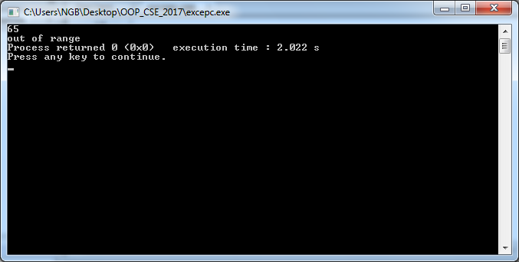
Output

Slide 99
Another Example
#include<iostream>
#include<exception>
using namespace std;
class userdefined:public exception
{public:
const char * what() const throw(){ return "out of range";}
};
void check(int x) throw (userdefined){
try{
if(x>60)
throw userdefined();
}
catch(userdefined & obj){cout<<obj.what();throw;}
}

Slide 100
Contd..
int main(){
int age;
cin>>age;
try{
check(age);
}
catch(exception &e){cout<<e.what();}
return 0;
}

Slide 101
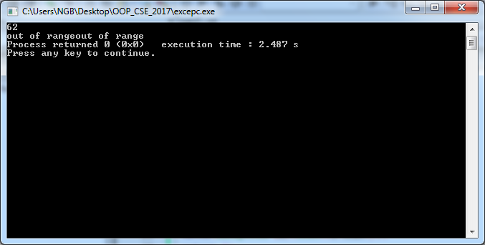
Output

Slide 102
catch(...)
catches all kind of exceptions
#include<iostream>
using namespace std;
int main(){
try{
int *p; int size;
cout<<"Enter the size"<<endl;
cin>>size;
p=new int[size];
throw 1;
}
catch(bad_alloc){
cout<<"bad_alloc";
}
catch(...)
{
cout<<"others";
}
return 0;
}

Slide 103
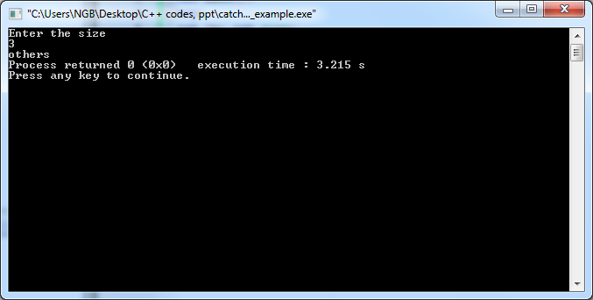
Output

Slide 104
Terminate function
std::terminate is what is automatically called in a C++ program when there is an unhandled exception.
This is essentially the C++ equivalent to C abort, assuming that you are reporting all your exceptional errors by means of throwing exceptions.
This calls a handler that is set by the std::set_terminate function, which by default simply calls abort.

Slide 105
Terminate function
std::terminate should be considered a last-ditch error reporting tool, even in C++.
The problem with std::terminate is that the terminate handler does not have access to the exception that went unhandled, so there's no way to tell what it was.
You're usually much better off wrapping the entirety of main in a try { } catch (std::exception& ex) { } block.
At least then you can report more information about exceptions that derived from std::exception (although of course exceptions that do not derive from std::exception would still end up unhandled).

